Slide 1


Introduction to Operating Systems CS 1550
Spring 2023
Sherif Khattab
ksm73@pitt.edu
(Some slides are from Silberschatz, Galvin and Gagne ©2013)

Slide 2
Announcements
Upcoming deadlines
Homework 2 is due next Monday at 11:59 pm
Lab 1 is due on Tuesday 2/7 at 11:59 pm
Project 1 is due on Friday 2/17 at 11:59 pm
Discussed in this week’s recitations
AFS Quota
You can check it using the command fs quota
You can increase it from accounts.pitt.edu.
Check README of Lab 1
VS Code issue
Turn off the usage of flock to lock files
Check my Piazza reply in Thoth Password thread

Slide 3
Previous Lecture …
Three usage problems of Semaphores
compromising mutual exclusion
Solution: Mutex
deadlock
Solution: Not yet discussed
priority inversion
Solution: priority inheritance

Slide 4
Question
How are processes created, maintained, and terminated?

Slide 5
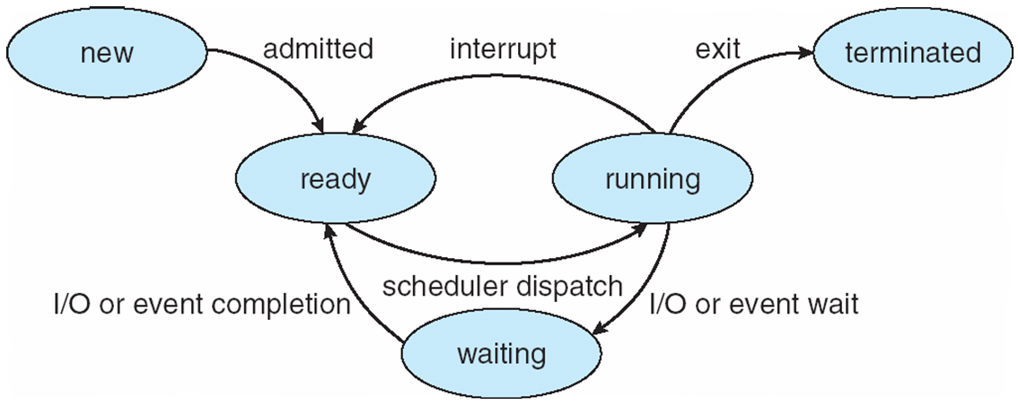
Process Lifecycle (AKA Process States)

Slide 6
Process Creation
Via fork() syscall
Parent process: the process that calls fork()
Child process: the process that gets created
Child process has a new context
new PCB

Slide 7
Process Creation
Memory of parent process copied to child process
Too much copying
Even not necessary sometimes
e.g., fork() followed by exec() to run a different program
Optimization trick:
copy-on-write
copy when any of the two processes writes into its memory
copy the affected memory “part” only
How would the OS know when a process writes to its memory?

Slide 8
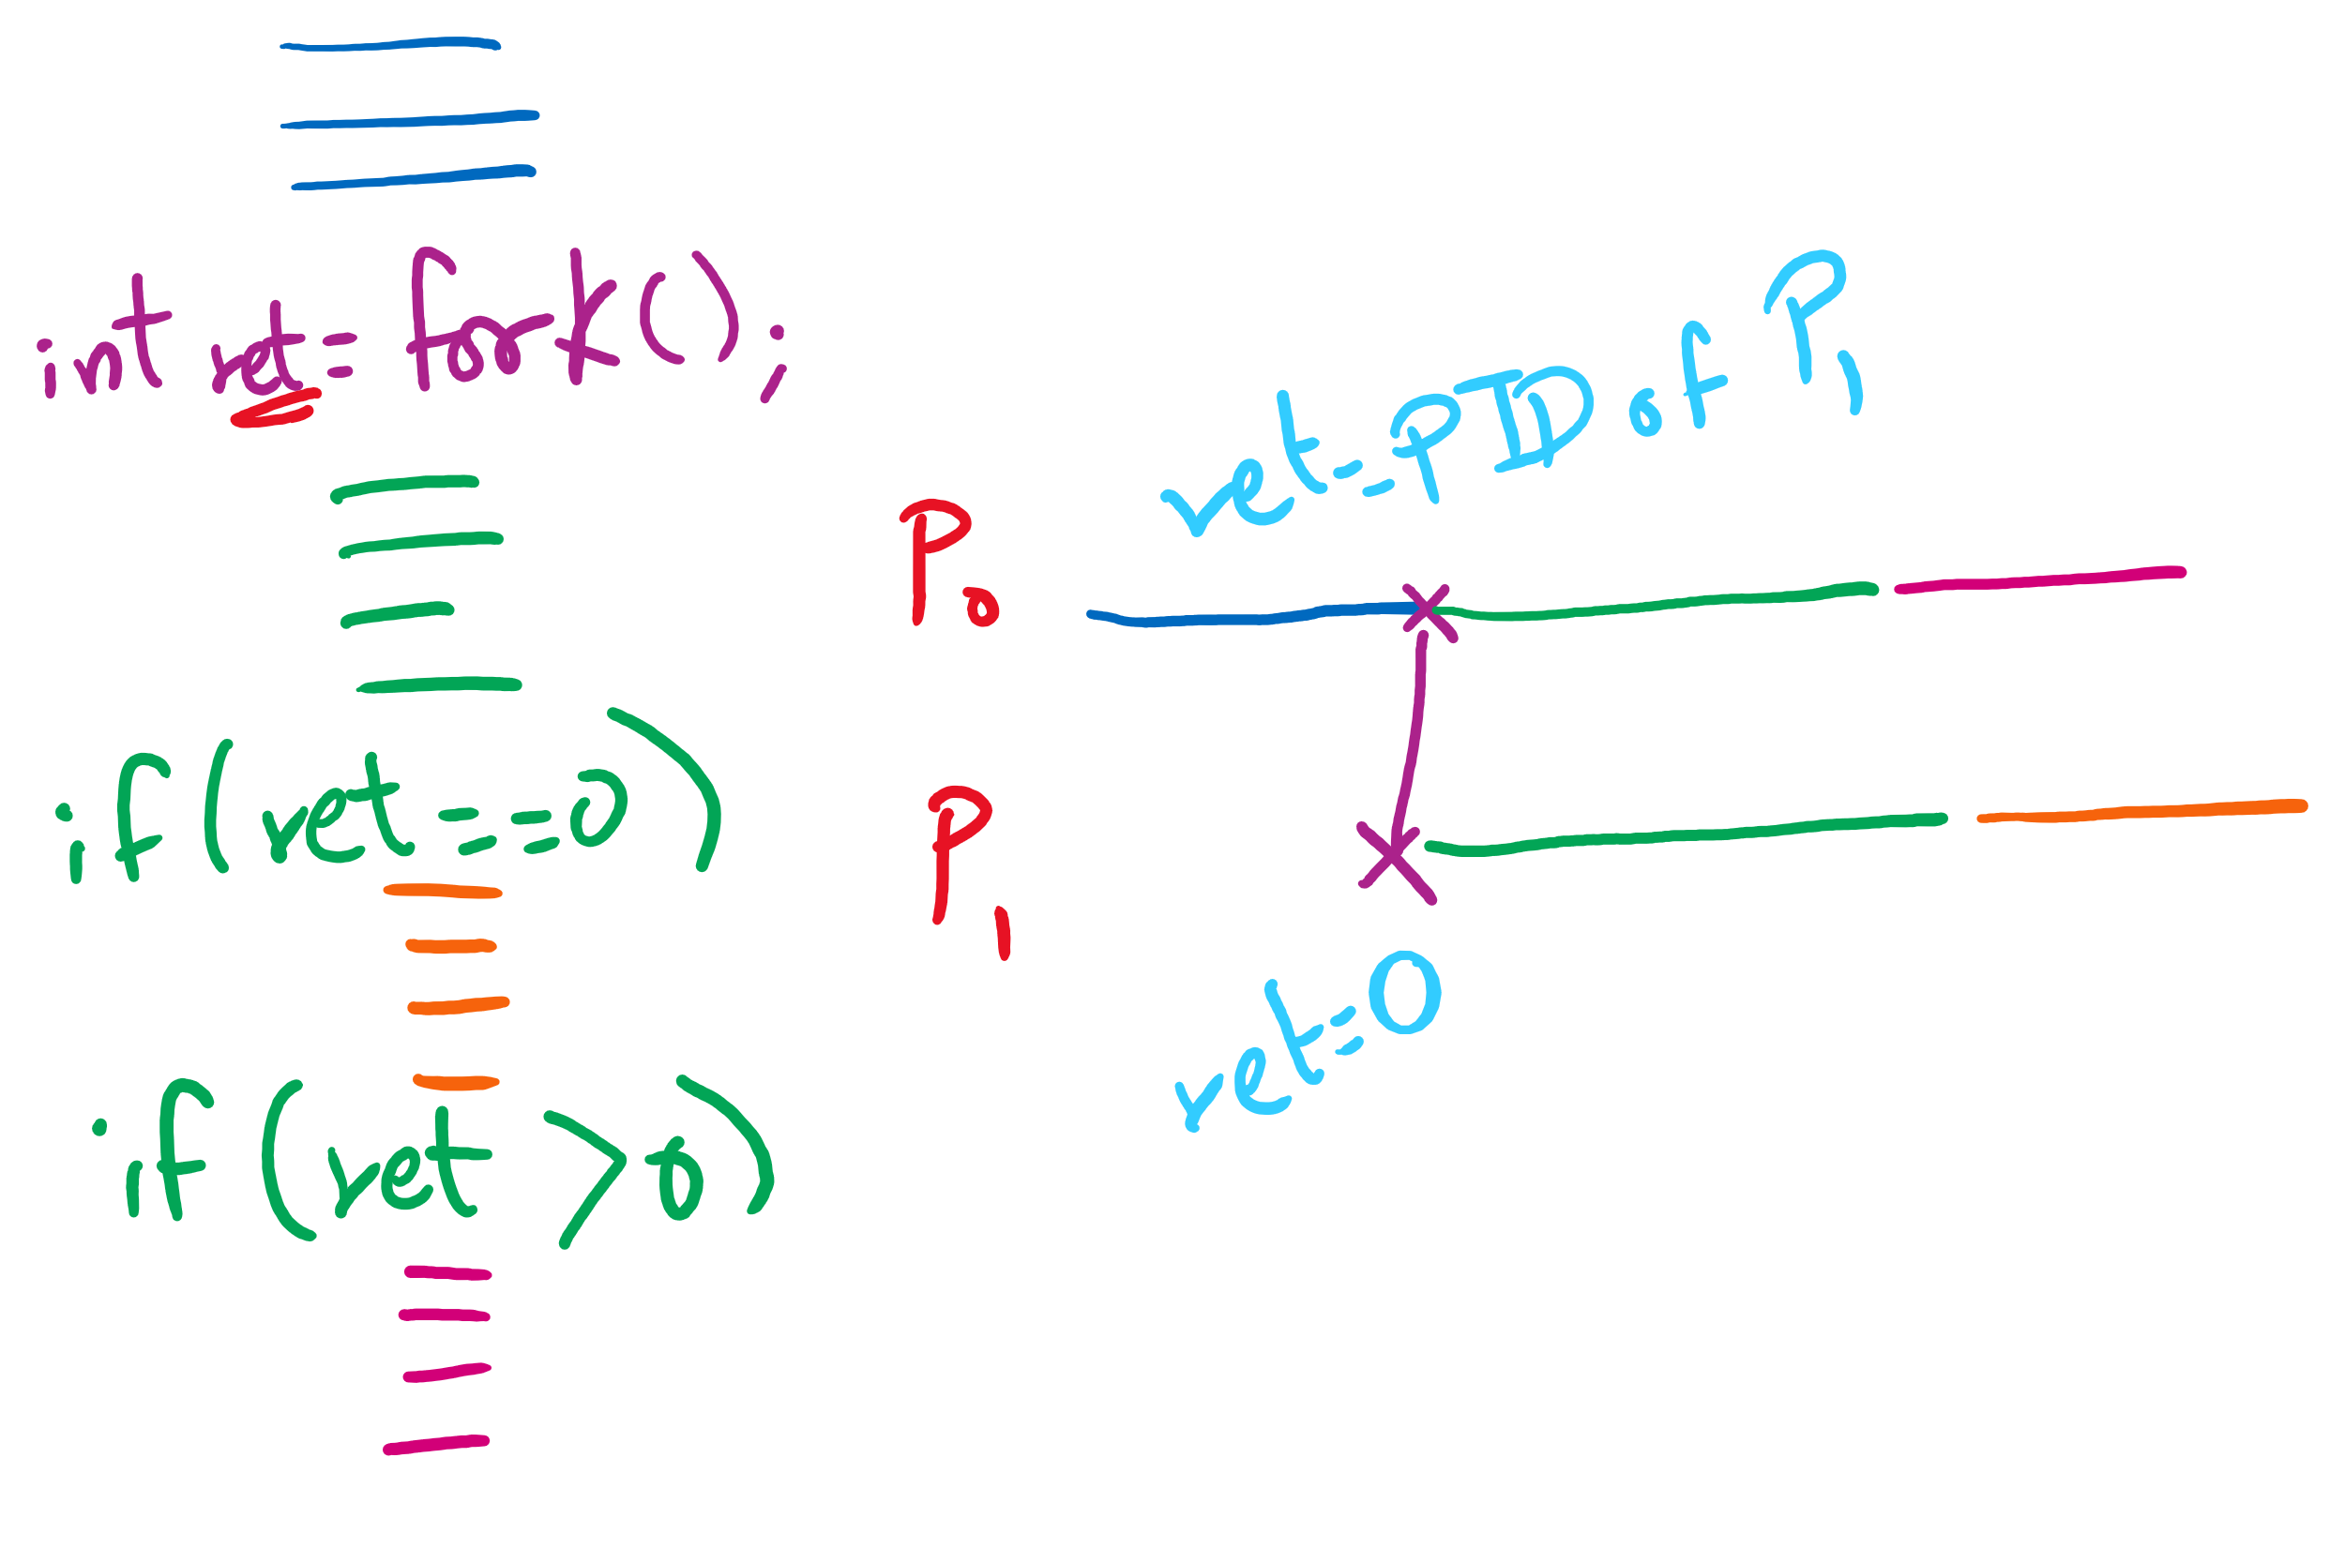
fork() tracing

Slide 9
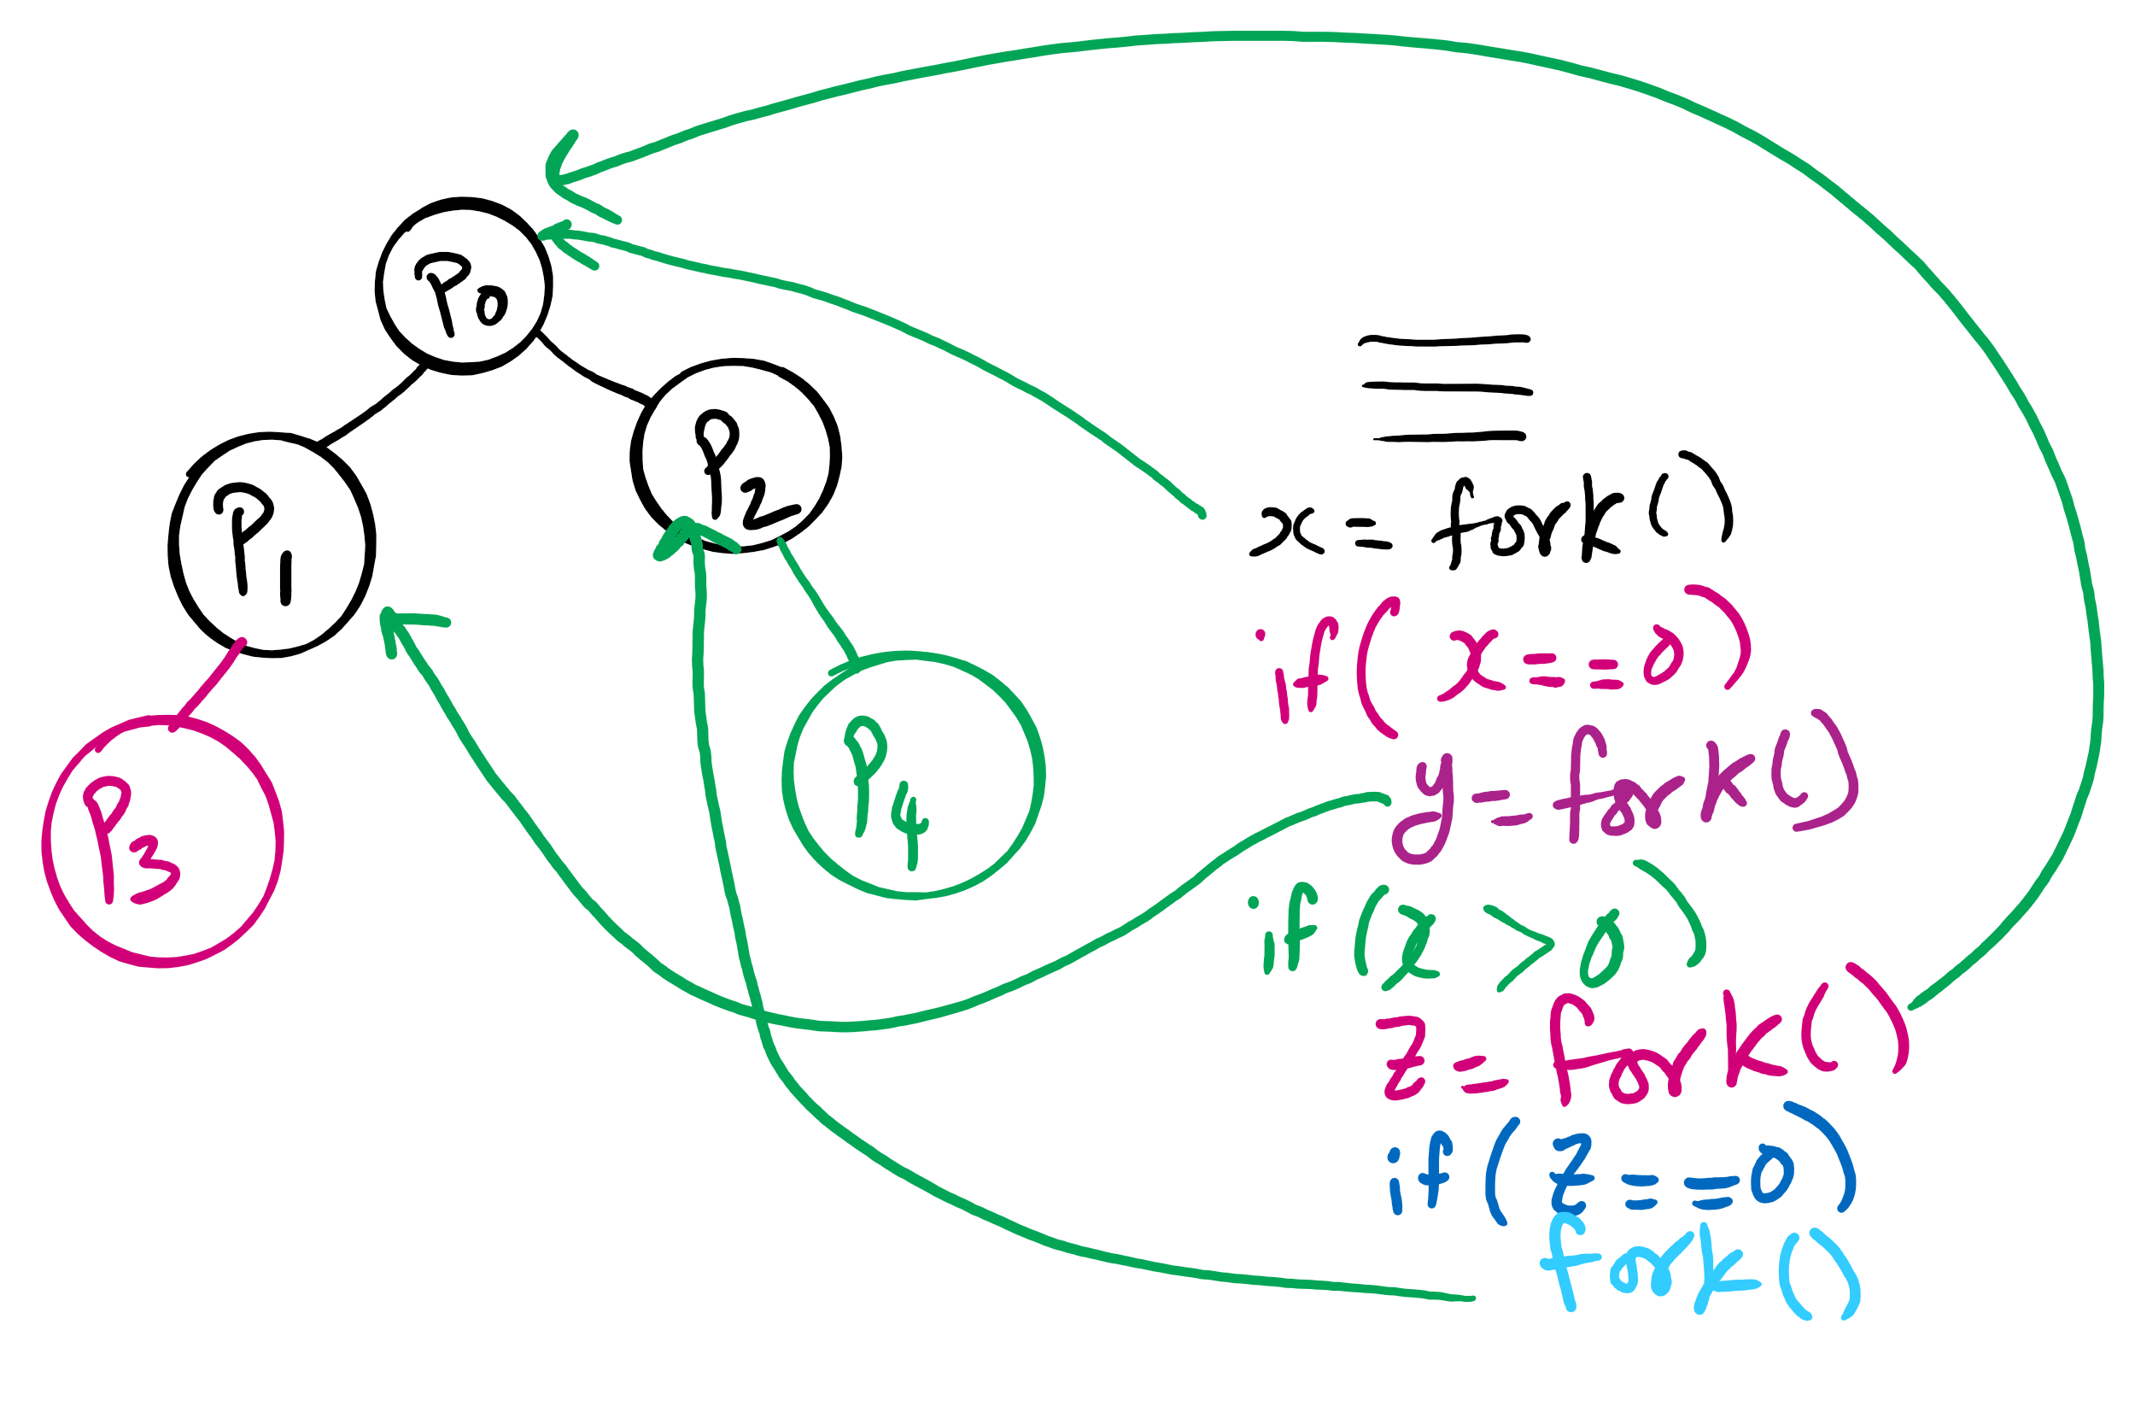
fork()’s of fork()’s

Slide 10
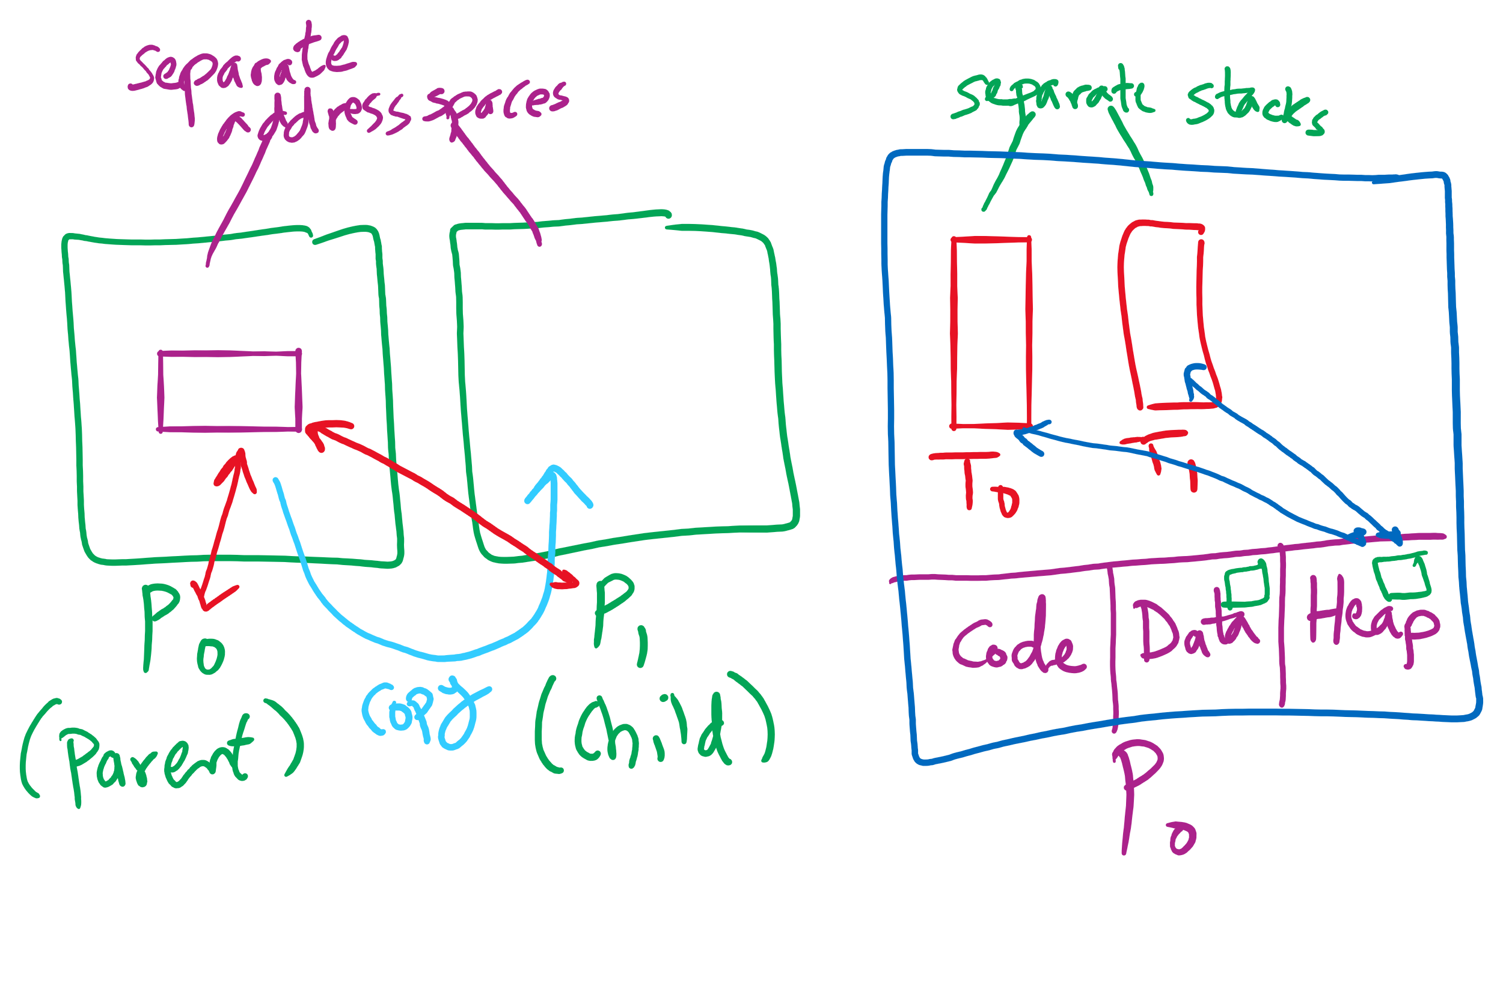
Process vs. Thread

Slide 11
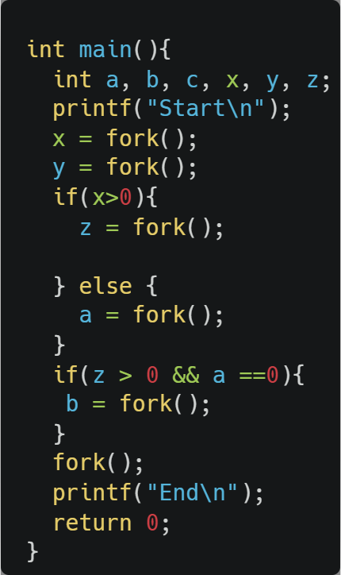
fork() example

Slide 12
Process Termination
Via exit(), abort(), or kill() syscalls
The parent process may wait for termination of a child process by using the wait()system call.The call returns status information and the pid of the terminated process
pid = wait(&status);
When a process terminates
If no parent waiting (did not invoke wait()) process is a zombie
If parent terminated without invoking wait , process is an orphan
adopted by the init process

Slide 13
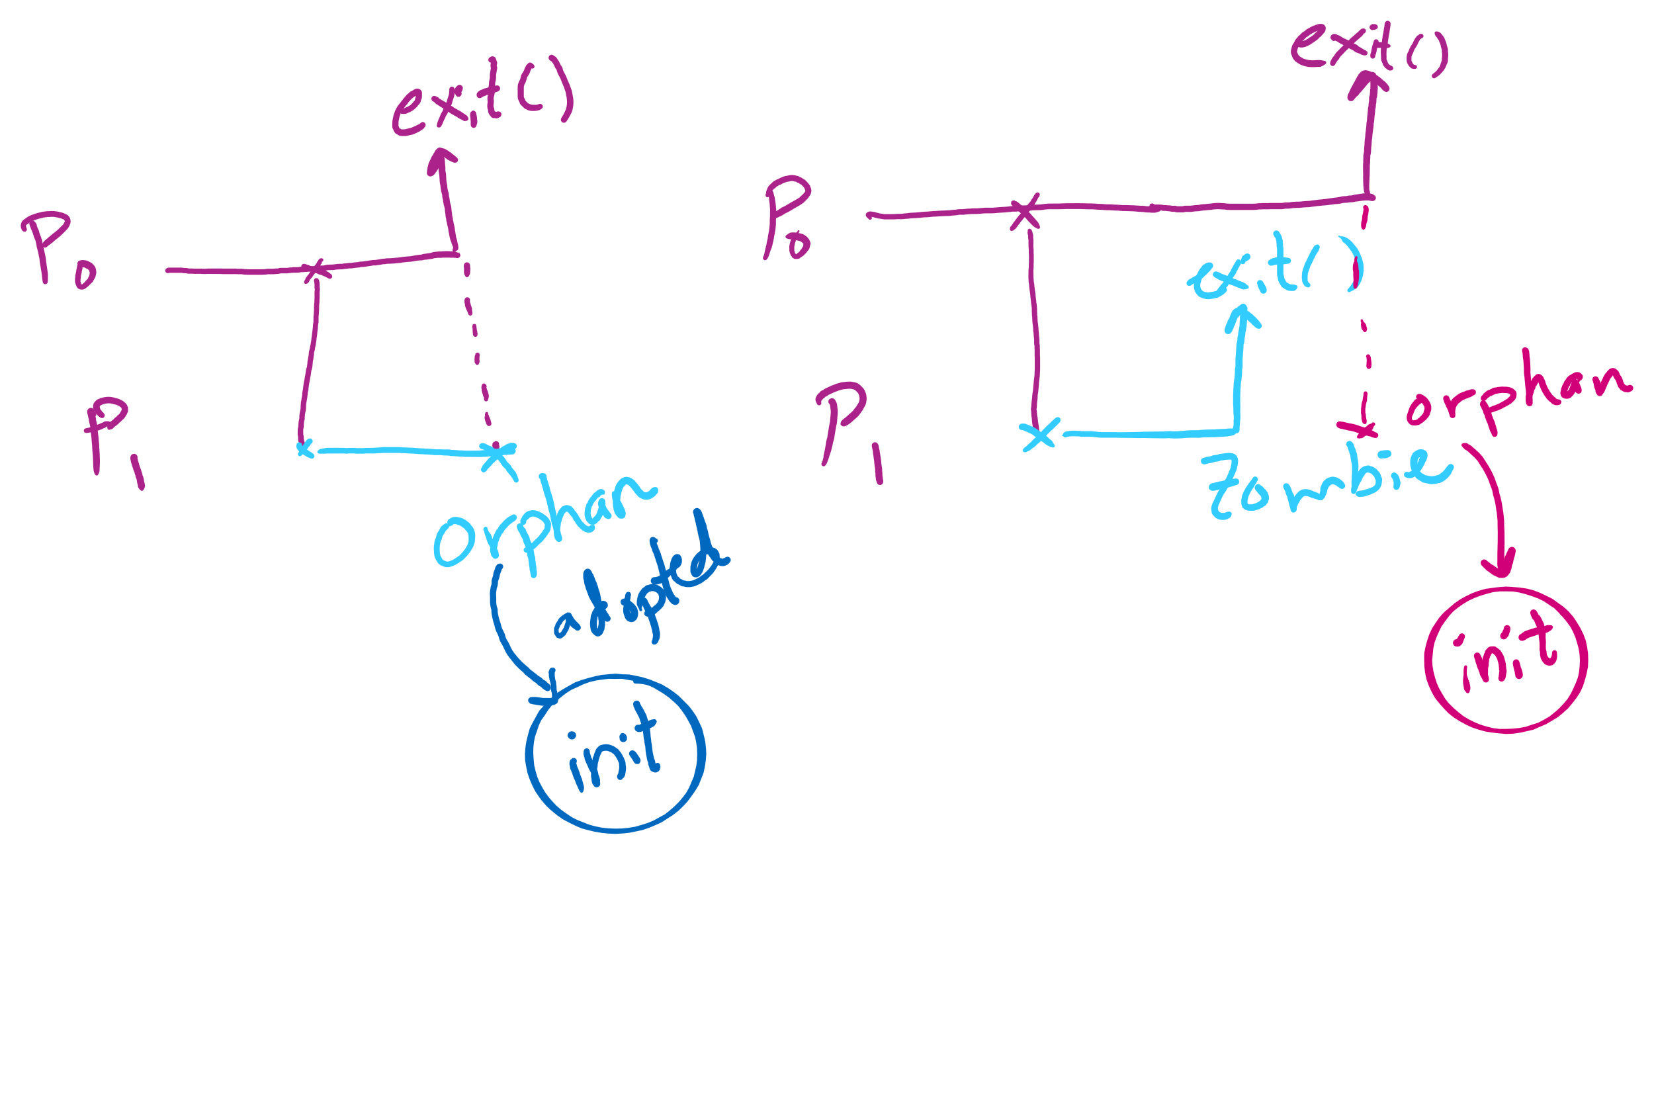
Orphan vs. Zombie Processes

Slide 14
Benefits of Orphan Processes
Allow a long-running job to continue running even after session (e.g., ssh connection) ends.
The nohup command does that
Create daemon processes
Long-running background processes adopted by the init process.

Slide 15
Thread Synchronization
Synchronization issues apply to threads as well
Threads can share data easily (same address space)
Other two issues apply to threads

Slide 16
Process vs. Thread

Slide 17
Bounded Buffer Problem
Bounded Buffer Problem
aka Producers Consumers Problem
A shared circular-array buffer with capacity n
A set of producer processes/threads
As set of consumer processes/threads
Requirements:
Never exceed the buffer capacity
Producers wait if the buffer is full
Consumers wait if the buffer is empty

Slide 18
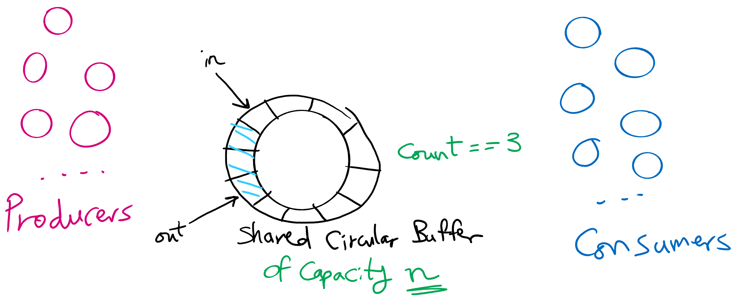
Produces Consumers Problem

Slide 19
Producers Consumers Problem is everywhere!
Access to User Interface elements in mobile applications
Main UI thread
Background threads
e.g., download files, check email on mail server
Background threads send requests to UI thread to update UI elements
Requests are stored in a shared bounded buffer
Which threads are the producers?
Who threads are the consumers?

Slide 20
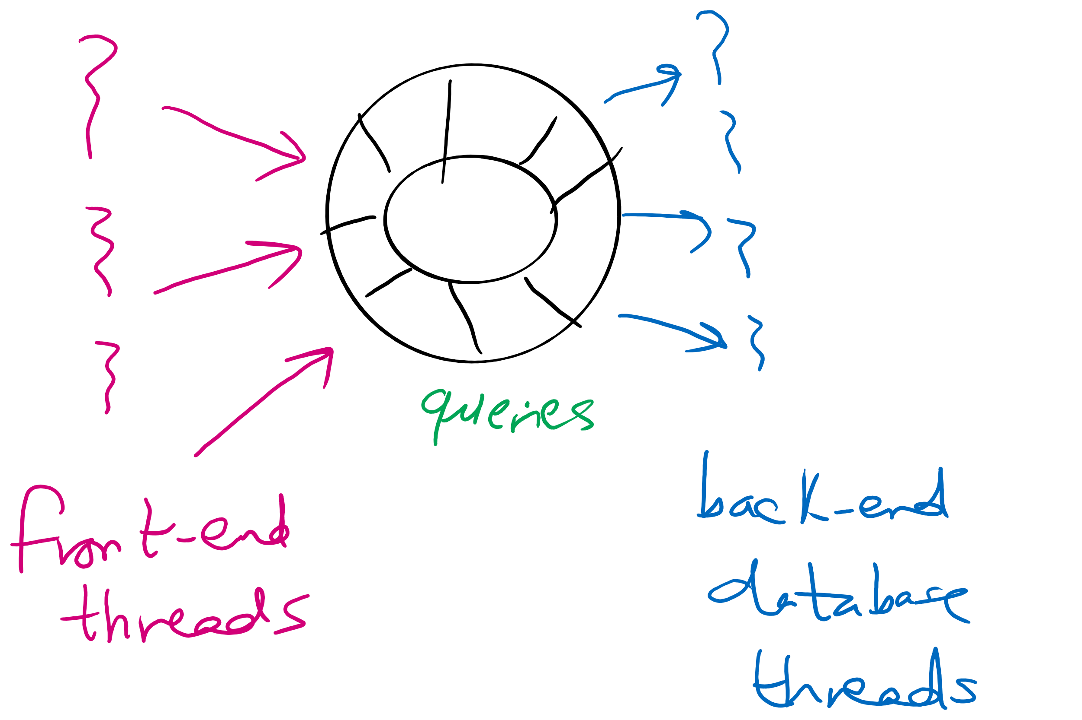
Producers Consumers Problem is everywhere!
Web Server
front-end processes/threads that interact with the HTTP connection from the client (e.g., browser)
Back-end processes/threads that execute database queries
Queries are inserted by front-end processes into a shared buffer
Which threads are the producers?
Who threads are the consumers?

Slide 21
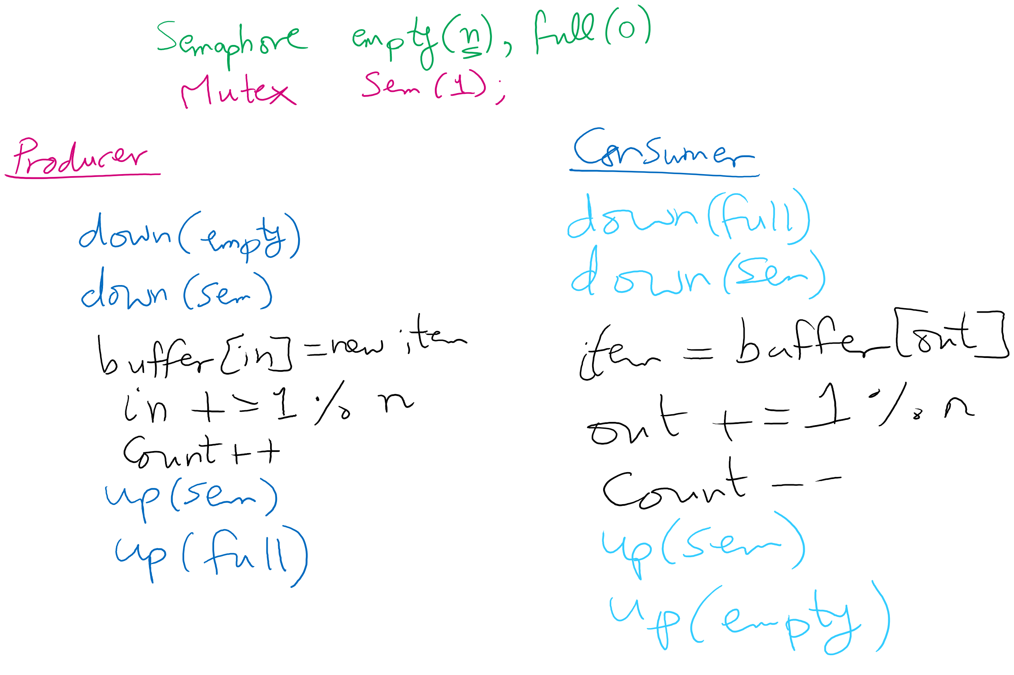
Solving Producers Consumers using Semaphores

Slide 22
How to trace the solution?
Let’s define some events.

Slide 23
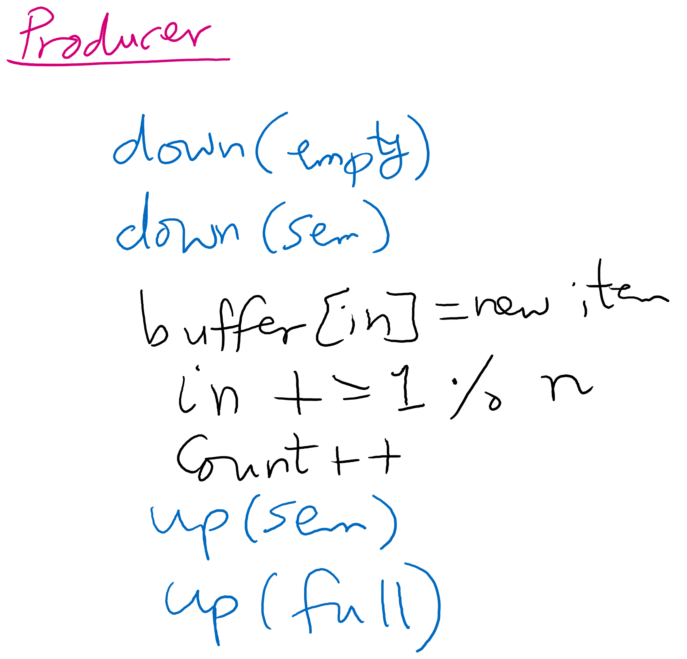
Producer arrives
Moves as far as possible until the solid line

Slide 24
Producer enters
Moves as far as possible past the solid line and until the dashed line

Slide 25
Producer leaves
Moves as far as possible until the dotted line

Slide 26
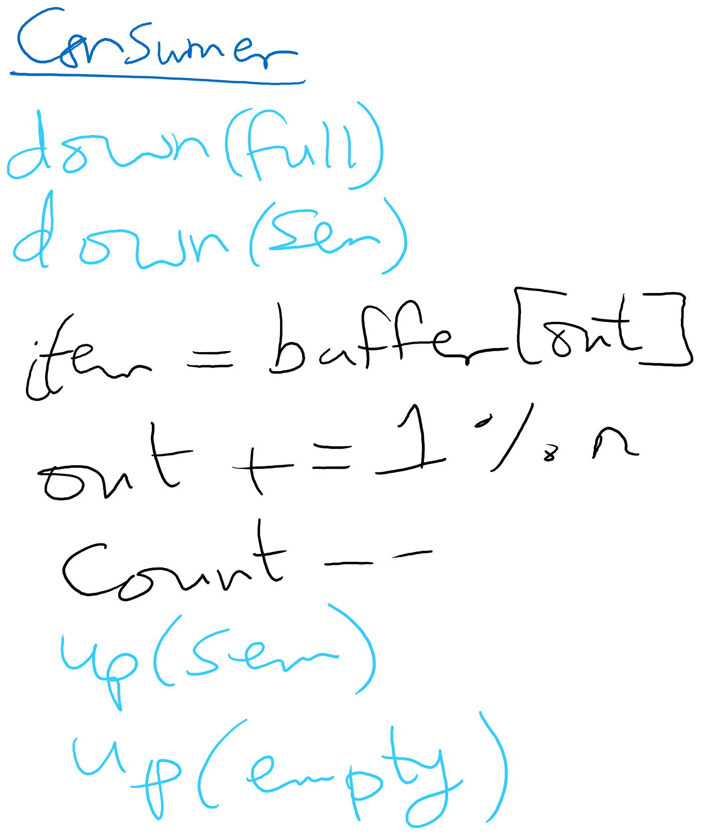
Consumer arrives
Moves as far as possible until the solid line

Slide 27
Consumer enters
Moves as far as possible past the solid line and until the dashed line

Slide 28
Consumer leaves
Moves as far as possible past the dashed line and until the dotted line

Slide 29
Tracing
Given a sequence of events, is the sequence feasible? If yes, what is the system state at the end of the sequence?

Slide 30
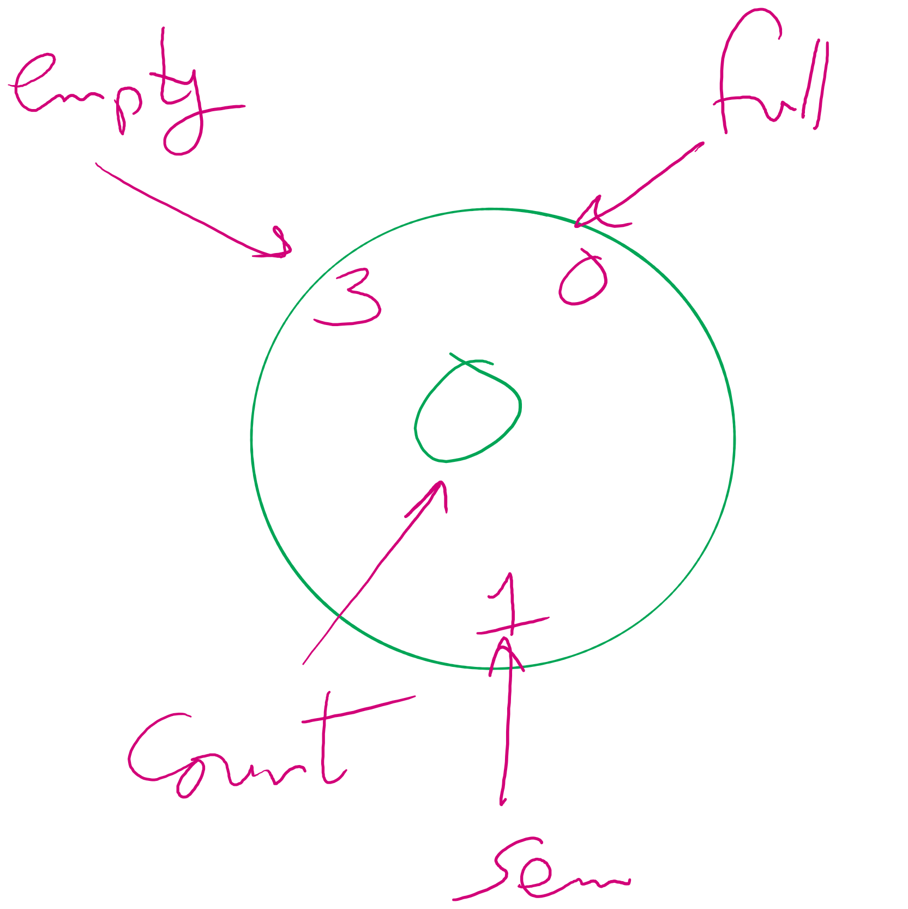
System State

Slide 31
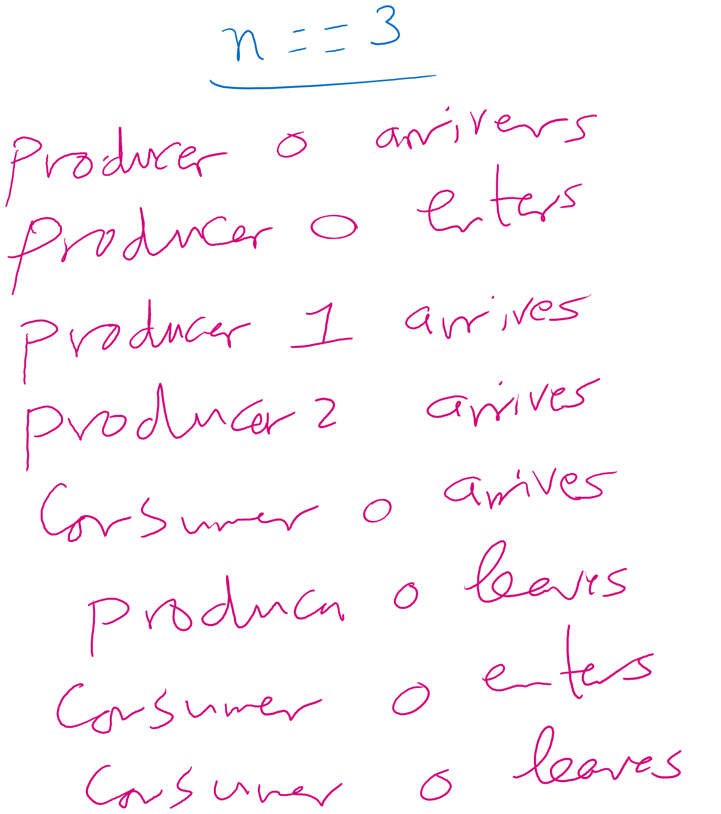
Example 1

Slide 32
Initial state
3
0
0
1

Slide 33
P0 arrives
2
0
0
0

Slide 34
P0 enters
2
0
1
0

Slide 35


P1 arrives
1
0
1
-1

Slide 36

P2 arrives
0
0
1
-2

Slide 37




C0 arrives
0
-1
1
-2

Slide 38
P0 leaves
0
-1
1
-2

Slide 39
P0 leaves
0
-1
1
-1

Slide 40
P0 leaves
0
-1
1
-1

Slide 41
P0 leaves
0
0
1
-1

Slide 42
C0 enters
0
0
1
-1

Slide 43
C0 enters
0
0
1
-2

Slide 44

C0 enters
0
0
1
-2

Slide 45
Can C0 enter?
0
0
1
-2

Slide 46
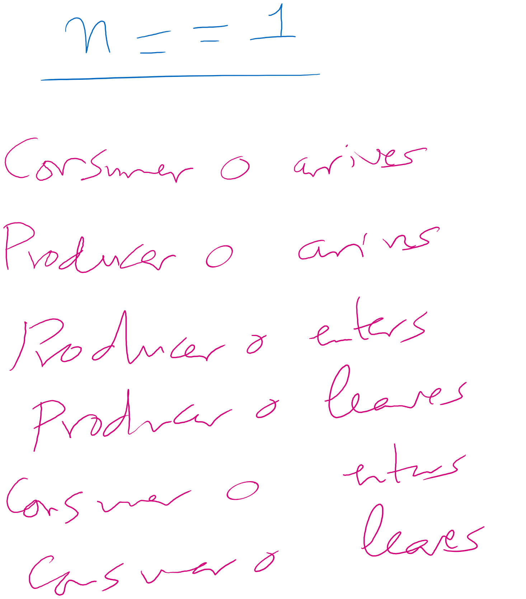
Example 2

Slide 47
Initial state
1
0
0
1

Slide 48
C0 arrives
1
0
0
1

Slide 49






C0 arrives
1
-1
0
1

Slide 50
P0 arrives
1
-1
0
1

Slide 51
P0 arrives
0
-1
0
1

Slide 52
P0 arrives
0
-1
0
0

Slide 53
P0 enters
0
-1
0
0

Slide 54
P0 enters
0
-1
1
0

Slide 55
P0 leaves
0
-1
1
0

Slide 56
P0 leaves
0
0
1
1

Slide 57
P0 leaves
0
0
1
1

Slide 58
C0 enters
0
0
1
1

Slide 59
C0 enters
0
0
1
0

Slide 60
Can C0 enter?
0
0
1
0

Slide 61
C0 enters
0
0
0
0

Slide 62
C0 leaves
0
0
0
0

Slide 63
C0 leaves
1
0
0
1

Slide 64
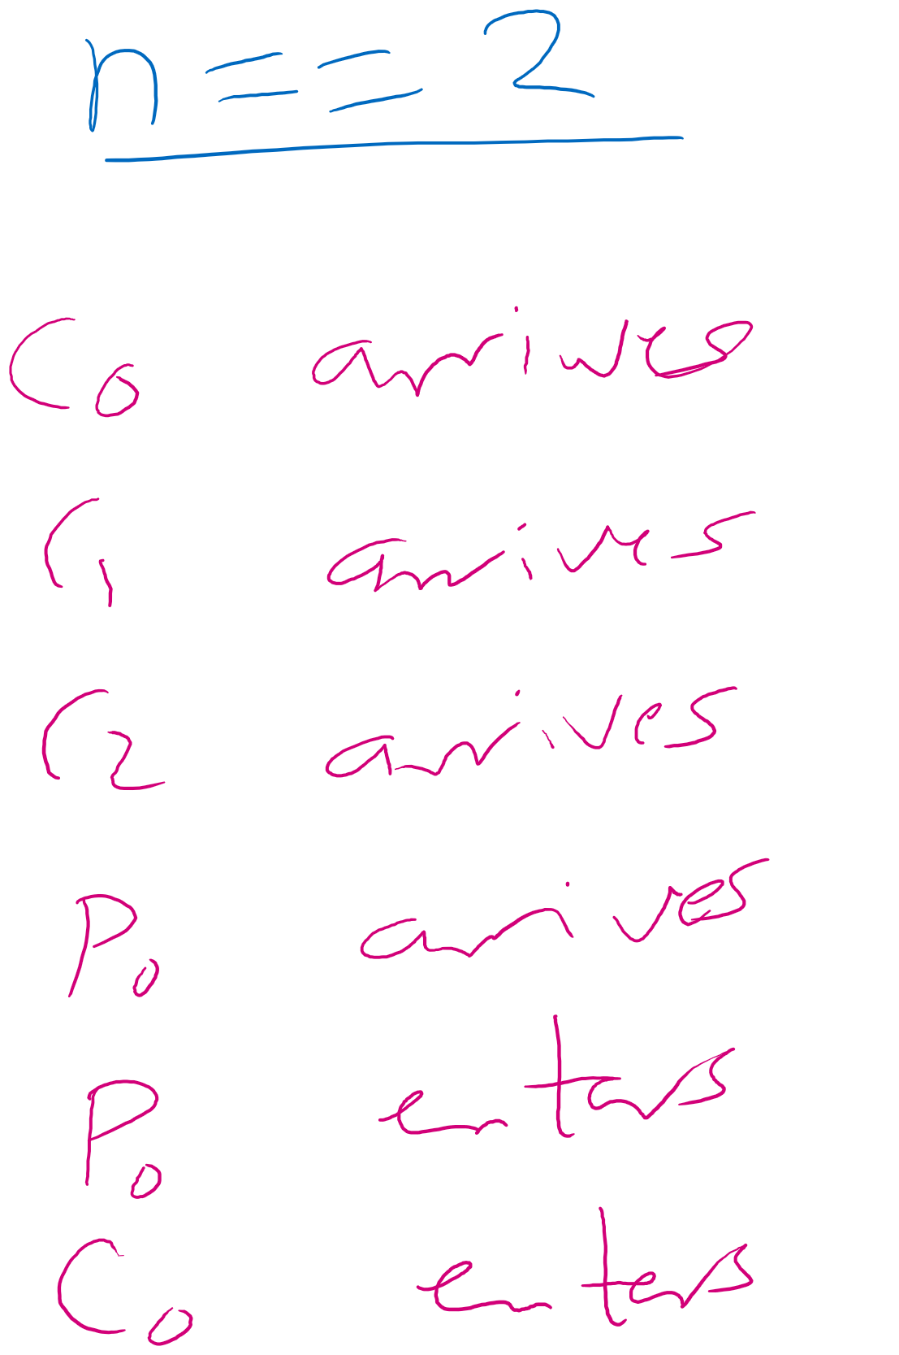
Example 3

Slide 65
Initial state
2
0
0
1

Slide 66
C0 arrives
2
0
0
1

Slide 67




C0 arrives
2
-1
0
1

Slide 68
C1 arrives
2
-1
0
1

Slide 69



C1 arrives
2
-2
0
1

Slide 70


C2 arrives
2
-2
0
1

Slide 71




C2 arrives
2
-3
0
1

Slide 72
P0 arrives
2
-3
0
1

Slide 73
P0 arrives
1
-3
0
1

Slide 74

P0 arrives
1
-3
0
0

Slide 75
P0 enters
1
-3
0
0

Slide 76
P0 enters
1
-3
1
0

Slide 77
C0 enters
1
-3
1
0

Slide 78
Can C0 enter?
1
-3
1
0

